Slide 1
Introduction to
Para-Equestrian Dressage
for Coaches & Athletes

Slide 2
Support for this course and outreach initiative is made possible by
Funding provided by the Department of Veterans Affairs Adaptive Sports Grant to Carlisle Academy Integrative Equine Therapy & Sports in partnership with the United States Equestrian Federation and the Professional Association of Therapeutic Horsemanship, International.
Disclaimer: This program is funded in part by a grant from the United States Department of Veterans Affairs. The opinions, findings, and conclusions stated herein are those of the author and do not necessarily reflect those of the United States Department of Veterans Affairs.

Slide 3
Disclaimer
The information in this presentation may not perfectly reflect the most updated USEF/USDF/FEI Para-Equestrian Dressage information and standards.
It is the responsibility of the athlete to check the USEF/USDF/FEI Para-Equestrian Dressage Rules updated annually.

Slide 4
Course Objectives
To develop a foundational understanding of National and International competition in Para-Equestrian Sports, specifically Para-Dressage & Para-Driving.
To raise awareness among riding schools, therapeutic riding centers, veteran service organizations and adaptive sport clubs about these exciting Paralympic and International equestrian sports as a competitive pursuit beyond equine-assisted therapy or recreation.
Connect emerging coaches and athletes to the USEF/USPEA International Para-Equestrian Dressage Centers of Excellence which provide training clinics, educational symposia, and access to international para-dressage coaching experts.
Encourage para-eligible veterans to participate in the Department of Veterans Affairs’ Veteran Assistance Program for Paralympic Athletes with trained, knowledgeable coaching support.

Slide 5
Presenter Michel Assouline Michel Assouline is the USEF Head of Para-Equestrian Coach Development & High Performance Consultant. He is an International Dressage/Para-Dressage Trainer with over a decade of Paralympic and FEI Dressage coaching experience, and most recently completed his 12-year term as Head Coach for the undefeated U.K Para-Dressage Team.

Slide 6
Primary Purpose of Para-Equestrian Sport
“The primary purpose of para-equestrian sport is to provide educational and competitive opportunities for athletes with physical impairments. Para-equestrian sports, in particular, opens a world of competition to riders whose impairments might preclude them from other forms of sport, and does so while providing a structured, focused, and highly competitive environment”. -USEF
USEUSEFUSEF

Slide 7
What is Para-Equestrian Dressage?
Para-Equestrian Dressage is an equestrian sport governed by the Federation Equestre Internationale (FEI), and is the only equestrian discipline that is included in the Paralympic Games, where it has been a regular fixture since 1996.
Para-Equestrian dressage is conducted in similar fashion to dressage, but with athletes divided into different competition grades based on their functional abilities.
Para-Equestrian Dressage is a sport where men and women compete together.
“Para” come from the term “parallel” to the Olympics, (not paraplegic) and is designed for the independent athlete with permanent, physical and visual disabilities seeking a competitive track.

Slide 8
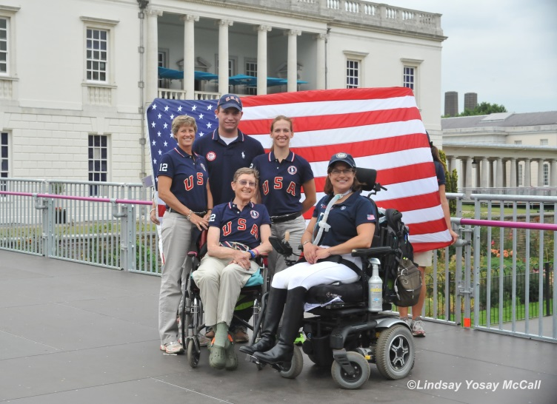
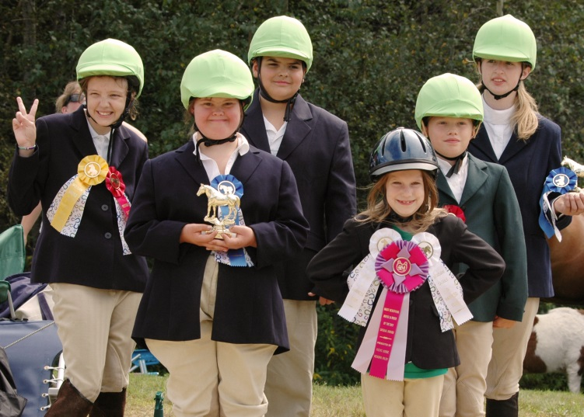
Paralympics not Special Olympics
Paralympics is an international competition, including para-dressage, that is regulated by the International Paralympic Committee (IPC), for athletes with permanent physical impairments. It occurs every 4 years.
Special Olympics is a separate organization sponsoring regional, national, and international competitions for athletes with intellectual impairments, and is not associated with the IPC or the FEI.

Slide 9
History of the Sport

Slide 10
Founder of the Sport
Around 1960, Jonquil Solt and Jane Goldsmith from the United Kingdom, with friends, started Para-Equestrian sport worldwide and inspired many people with disabilities. They built the sport up until FEI took over.
Mrs. Solt is still around and a very remarkable woman: She often said:
“Disability is a state of mind”
“Everything that is possible, is achievable.
“Lots of so-called able-bodied people are disabled, because they think ‘I cannot do it’.
“Lots of people whom the able-bodied regard as disabled, think ‘I can do this’ - - and they do it.”

Slide 11
History of the Sport
Around 1960 Jonquil Solt and friends started to organize in Great Britain and the Scandinavian countries the Para Equestrian Competitions.
1952 Liz Hartel, a rider with effects of polio competed at the Stockholm Olympics
1985 Test event in the USA
1987 World Championships in Sweden
1991 European Championships in Denmark
1994 World Championships in United Kingdom borrowed horses
1996 Paralympic Games Atlanta borrowed horses
2000 Paralympic Games Sydney borrowed horses
2003 World Championships Belgium (transition from borrowed horses to own horses)
2004 Paralympic Games Athens own horses/borrowed horses
2006 Integration into FEI
2007 World Championships in Hartpury own horses
2009 European Championships in Norway own horses
2008 Paralympic Games Beijing (Hong Kong) own horses
2010 World Equestrian Games Kentucky USA own horses
2011 European Championships in Belgium own horses
2012 Paralympic Games London own horses
2013 European Championships in Denmark own horses
2014 World Equestrian Games Caen France own horses
2015 European Championships in France own horses
2016 Paralympic Games Rio de Janeiro own horses
2017 European Championships in Sweden own horses

Slide 12
Understanding the Sport in the U.S. Today
Para-Equestrian Dressage in the U.S. is a growing sport with over 150 registered, classified athletes. The discipline is governed by our national federation, the U.S. Equestrian Federation (USEF), which oversees all rules, officials, and standards of all recognized equestrian sports. US Equestrian also runs the High Performance Programs, selects and fields U.S. Teams, and is the national federation recognized by the international federation, the Federation Equestre Internationale (FEI).
“US Equestrian is dedicated to uniting the equestrian community, honoring achievement, and serving as guardians of equestrian sport. Since its inception in 1917, US Equestrian has been dedicated to pursuing excellence and promoting growth, all while providing and maintaining a safe and level playing field for both its equine and human athletes.”
FMI Contact:
USEF Para-Equestrian Director, Laureen Johnson (lkjohnson@usef.org)
USEF Head of Coach Development & High Performance Consultant,
Michel Assouline (michel@assoulinedressage.com)
Para-Dressage Chef d’Equipe Kai Handt, (kaihandt@yahoo.com)
FMI: USEF/Para-Dressage

Slide 13
What is USPEA?
The United States Para-Equestrian Association is a recognized National Affiliate of the United States Equestrian Federation (USEF), “and assists athletes with eligible physical impairments in expanding their knowledge and experience in the disciplines of Para-Equestrian sports”.
FMI Contact: Hope Hand, President
(hope@uspea.org)
FMI: USPEA

Slide 14
What is USDF?
The United States Dressage Federation is a recognized National Affiliate association of the United States Equestrian Federation (USEF), and is “dedicated to education, recognition of achievement, and promotion of dressage.”
Athletes with physical impairments riding in Para-Equestrian Dressage will need to register their horse and themselves in order to enter recognized shows, and will refer to USDF/USEF Para-Equestrian Dressage rules for recognized competition. USDF clarifies dressage protocol, etiquette, and manners for dressage competitors.
FMI: USDF

Slide 15
What is FEI?
The Federation Equestre Internationale (FEI), founded in 1921, is the sole controlling authority for all international events in Dressage & Para-Equestrian Dressage, Jumping, Eventing, Driving & Para-Equestrian Driving, Endurance, Vaulting and Reining. The FEI establishes the regulations and approves equestrian competition at Championships, Continental and Regional Games, and the Olympic and Paralympic Games.
“The primary mission of the FEI is to advance the orderly growth of equestrian sport worldwide by promoting, regulating and administering humane and sportsmanlike international competition in the traditional equestrian disciplines.”
- FEI Mission Statement
FMI: FEI

Slide 16
What is a Para-Dressage Center of Excellence?
The USEF/USPEA COEs are being developed nationwide and are the focus for Para-Equestrian Dressage trainer/coach identification and development programs to expand the availability of quality Para-Equestrian sport programs and services.
The COEs are the primary hubs for delivering the USEF Para-Equestrian Dressage Emerging through High Performance Programs, and offer training in FEI/USEF Classification, Human Sports Science & Medicine (Human SSM) and Equine SSM.
FMI: COE's

Slide 17
Where are the Centers of Excellence? As of October 2017
North Texas Equestrian Center (NTEC), Wylie, TX
http://uswarmblood.com/
Contact: Kai Handt, Kaihandt@yahoo.com
Carlisle Academy – Lyman, ME
http://carlisleacademymaine.com/
Contact: Sarah Armentrout, sarmentrout@carlisleacademymaine.com
Ride On Therapeutic Riding Center, Chatsworth, CA
http://www.rideon.org/
Contact: Megan McQueeney, jrsporthorses@gmail.com
Healing Strides of VA – Boones Mill, VA
http://www.healingstridesofva.org/
Contact: Carol Young, carol@healingstridesofva.org
Wheatland Farm Equestrian Center – Purcellville, VA
https://www.wheatlandfarm.org/
Contact: Muriel Forrest, amurielforrest@gmail.com
Vinceremos Therapeutic Riding Center – Loxahatchee, FL
https://vinceremos.org/
Contact: Susan Guinan, info@vinceremos.org

Slide 18
What is the Sport Pathway?
Within the context of para-equestrian dressage, US Equestrian is responsible for the development of the pathway which supports competition, training, and education opportunities.
The pathway is made up of EMERGING, DEVELOPMENT, and ELITE Athletes.
As the National Affiliate, the United States Para-Equestrian Association assists by identifying and nurturing emerging athletes at the grassroots level.

Slide 19
DELIVER
ELITE
DEVELOPMENT
DEVELOP
IDENTIFY, NURTURE & EDUCATE
EMERGING

Slide 20
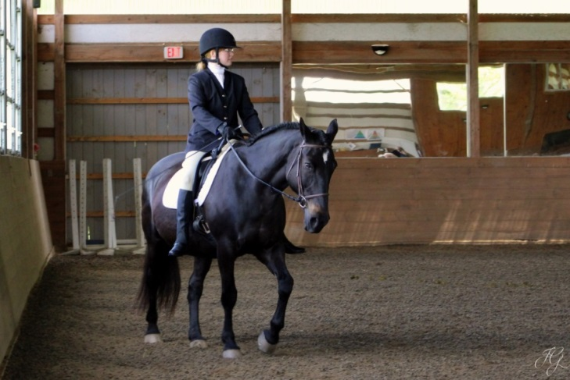
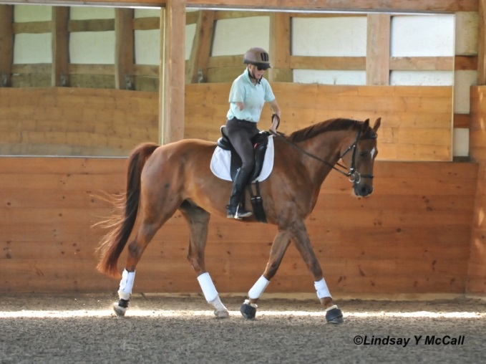
Pipeline Development
Elite Athlete, Developing Athlete, & Emerging Athlete all have distinct stages of development, definitions, support structure, and competition criteria.
Official USEF Para-Dressage Program Structure & Pathways

Slide 21
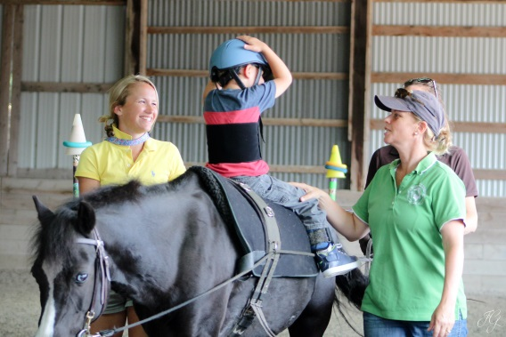
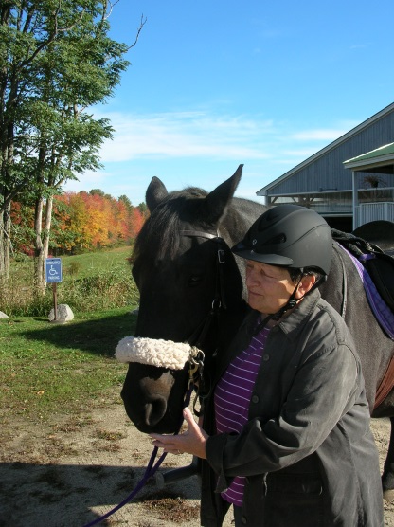
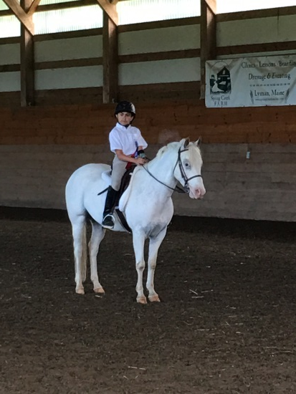
Talent Identification
PATH Centers
Centers of Excellence
Paralympic Sport Clubs
U.S. Pony Clubs
Traditional Dressage Competitions
Veteran Service Organizations
All have athletes with permanent, measurable impairments who may have an interest in pursuing a competitive para-equestrian track.

Slide 22
Paralympic Equestrian Sport Initiative for Veterans

Slide 23
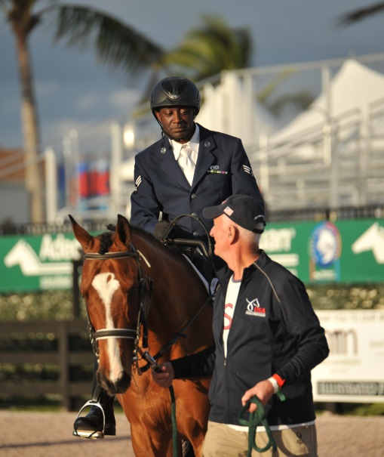
Veteran Opportunities in Equestrian Sports
Challenging Equestrian Sport Beyond Equine-Assisted Therapies & Activities
Skill Progression & Meaningful Participation
Health & Wellness Through Sports
Representing Our Country

Slide 24
Goals of Veterans Initiative
In partnership with the United States Equestrian Federation, the U.S. Department of Veterans Affairs, and PATH, International, the goals of this initiative are to increase para-eligible veteran participation in Paralympic Equestrian Sports (specifically Para-Dressage) and Para-Driving.
Clinics, outreach, and ongoing education create access to international gold-medal coaching experts and sport-specific classification.
Para-eligible veterans are encouraged to participate with the VA’s Veteran Assistance Program for Paralympic Athletes.
National Para-Equestrian Coach Development Program is designed to create exponential impact on coaching support to para-eligible Veterans.
Coordinated Veterans-oriented competitions/games would promote inclusion of Para-Equestrian sports.

Slide 25
Veteran Assistance Program
Link to Department of Veterans Affairs’
Veterans Monthly Assistance Allowance Program
FMI Contact: Coordinator of Veterans Paralympic Equestrian Sport Initiative:
Sarah Armentrout, Head of School,
Carlisle Academy
(sarmentrout@carlisleacademymaine.com)

Slide 26
Competition Readiness Stages of Development

Slide 27
Types of Para-Dressage Competitions
Competitions are broken into various levels:
Onsite, center-based schooling shows – Para Test of Choice/Novice Tests A&B/Borrowed School horse
Local/regional schooling shows – Para-Test of Choice/Novice & Individual Tests for each grade/Borrowed horse or own mount
Recognized Shows (USDF/USEF) Individual/Team/Freestyle tests all shown/Own mount
International Shows (FEI CPEDI’s) Individual/Team/Freestyle tests all shown/Own mount
USEF Virtual Judging Program (online showing, videotape rides and submit), FMI: Virtual Judging Specifications

Slide 28
Eligibility For Competitions & Awards Offered within the U.S.
North American Junior & Young Rider Championships
U25 Championships
Para-Dressage Nationals
FEI 1*, 2*, 3*’s each season, which may act as qualifiers for the World Equestrian Games (WEG) or the Paralympics, depending on the competition cycle.
USDF Para-Dressage Rider & Horse of the Year Awards
FMI – Visit USEF/Para-Equestrian Website for annual competition calendar & updates

Slide 29
International Para-Dressage Events
CPEDI 1* International Event with 4 Nations Invited
CPEDI 2* International Event with 4 Nations Invited but at a Higher Level
CPEDI 3* International Event with a Minimum of 6 Nations Invited
Championships (such as World Equestrian Games, World Championships, European Championships)
Paralympic Games

Slide 30
Where to Find Tests & Rules
All FEI tests can be located online at FEI Para-Equestrian Page: FEI Para-Dressage Tests
Each Grade has its own series of tests: Novice Test, Team Test, Individual Test, and Freestyle Test.
All FEI rules can be located online at FEI Para-Equestrian Page: FEI Para-Dressage Rules
National USEF/USDF Rules can be found online at USEF Para-Dressage Webpage
Tests & Rules can also be found electronically with visual diagrams on the FEI Para Tests EQUITESTS App (through any APP store).

Slide 31
Preparing for your First Competition (Local Level)
Preparation is the name of the game in dressage competition:
Ask Show Management to add para-equestrian dressage test of choice.
Both horse and athlete must be prepared physically and mentally, not only for the tests ahead but for the action and excitement of a competition. The athlete should practice tests at home, travel to local show venues, consider having a trainer ride the horse at its first outing.
Preparation should also include proper grooming, braiding, turnout, and use of a hired groom, if needed.
Scores in 50’s at local shows means more practice. 60’s and above, consider a recognized event.

Slide 32
Competing Memberships and Documents (National Level)
Memberships: www.USEF.org and www.USDF.org
Athlete must have: USEF Competing Membership or USEF Show Pass Fee and USDF Participating (PM).
Athlete should choose “Para-Equestrian Option” for USEF Membership.
Athlete must present: USEF Adult Amateur Card (If entered in adult amateur classes)
Horses must have: USDF Horse Identification (HID) number or USDF Lifetime Horse Registration (LHR), Current Coggins Date and Health Certificate when traveling across some State Lines. www.horsecouncil.org or 202-296-4031
Owner: USEF Competing Membership or Show Pass Fee, USDF PM, GM, or NM
Trainer, Coach, Handler: USEF Competing Memberships

Slide 33
Entering a Recognized (USEF/USDF) Competition and What to Submit
USEF and USDF documentation cards for horse, rider (trainer), owner and coach
Original Signatures are required for Rider, Trainer, owner and Coach
Coach is any adult who receives remuneration for teaching, schooling, advising
Trainer is an adult (18 or older) physically present on show grounds, that is responsible for the Health and Welfare of the Horse, most likely this is the rider.
Minor: Under age 18. A responsible adult must sign the entry form
Citizenship: All entry forms must request rider citizenship
Coggins test for each horse
Para Dressage Classes: 3 copies of “Dispensation Certificate” and attach these to a copy of the ridden test.
(Note: If para-dressage rider competes in an traditional dressage class, rider must still present copies of dispensation certificate).

Slide 34
Know USEF Drug Rules
DRUGS: USEF drug rules are very specific. Any drug that stimulates, tranquilizes, depresses, locally anaesthetizes, or masks said drugs are illegal.
See link for WADA Website (drug list)
Testing at an Event: USEF has authority over your horse and may drug test unannounced, at any time by a designated veterinarian.
Drug Hotline: (800)633-2472. Call when in doubt.

Slide 35
Understanding International Competition

Slide 36
The role of the FEI Para-Equestrian (PE) Committee and Officials
FEI PE Committee is the advising body to the FEI and the National Federations about rule changes and appointments of officials etc.
International PE Judges who are licensed in Para-Equestrian Dressage and attend educational clinics run by the FEI regularly.
International Stewards are specialists in the specific PE Rules.
International Classifiers are specialists in classification of the athlete in the correct grades.
Technical Delegate, Appeals Committee, Veterinary Commission and Delegate are specialists and are appointed by the FEI for every International event.

Slide 37
International PE FEI Judges
Judges are divided in 3 categories:
PE 3* Judges
PE 4* Judges
PE 5* Judges
All the PE Judges have to fulfill the FEI requirements and must be at least at Prix St. George certification (=USEF ‘R’) Dressage Judges in their National Federations.

Slide 38
PE FEI Stewards
Are responsible for supervision and timing during the warming up (trainer warms up the Grade I and II horses).
Responsible for the time allowance in the warming up arenas per country.
Are responsible for the arenas and stables.
Organize the Horse Inspection.
Check the correct use of the compensating aids/bits etc.
Monitor the welfare of the horse during the whole competition.
Coordinate with the Technical Delegate (TD) in the TDs report to the FEI.

Slide 39
PE Technical Delegate and Classifiers
Technical Delegate works closely together with the Organizers and other Officials before and during the Event. Will report to the FEI.
Technical Delegate will be appointed by the OC/ FEI and is present at all the International competitions.
Classifiers classify athletes into the correct sport class prior to competition and inspection. Once all the classifications are completed, the classifiers work with the other show officials to ensure a fair competition.

Slide 40
Para Dressage Rules Highlights FEI & USDF Rules are updated annually. Check accordingly.

Slide 41
Dressage Tests
In Grade I tests: athletes compete at walk.
In Grade II tests: athletes compete at walk and trot.
Grade I and II may be combined when they are less than 4 entries in either class. Each grade rides its own test, and the result is calculated by comparing percentages.
In Grade III tests: athletes compete at walk and trot.
In Grade IV tests: athletes compete at walk, trot with lateral work, and canter.
In Grade V tests: athletes compete at walk, trot and canter with lateral work.

Slide 42
Schooling of Horses at Competitions
For safety reasons, riding is not permitted in an arena where lunging is taking place.
Horses for Grades I, II and III may be ridden for up to 30 min per day by the trainer/coach or another rider designated. An Official Steward must be present. Horses for Grades I, II, III may not be trained for the 15 min before they enter the competition arena to perform their Dressage test.
Horses for Grades IV and V may only be schooled by the athlete competing on that horse.
No horse may be schooled outside the designated schooling times (and areas) without the permission of the Technical Delegate or Chief Steward.

Slide 43
Friendly/Companion Horse at Competitions
A “friendly horse” (companion horse) is allowed to stand adjacent to the arena during competitions for Grades 1 through 3.

Slide 44
Use of Voice at Competitions
Athletes in Grades I, II and III may use their voice as an aid, while riding in their allocated grade, provided they do so in moderation. Athletes in Grades IV and V may not use the voice, unless stated as a compensating aid.
Once a test has started, the athlete shall not speak to any other person.

Slide 45
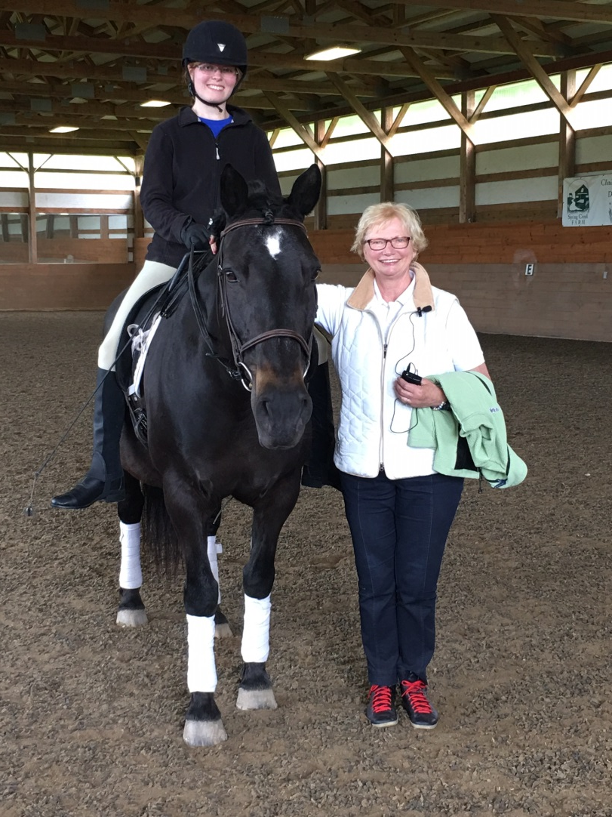
Maximum Competitions Per Day
Athletes: a maximum of 2 tests per day per horse.
Major championships: no athlete may ride more than one horse in competition.
All other competitions: one athlete may ride 2 horses in their Grade.

Slide 46
Compensating Aids - Defined
Compensating aids are used to compensate for the physical or sensory limitation resulting from an athlete’s impairments, thereby enabling him/her to participate in sport. These aids must not give the athlete any advantage beyond compensating for the impairment, or may be used for safety reasons.
They are divided into two types:
Adaptation or modification to compensate for loss of function (loop reins for a rider with poor grasp) and poor control of limbs (securing stirrup leathers to the girth)
Aids to assist the rider (callers, whips)

Slide 47
Examples
A rider without legs may carry two whips
A rider with one arm may ride with one hand only
A visually impaired rider may have “living letters” (callers) around the arena.

Slide 48
Aids to Compensate for Memory or Cognitive Impairment
Commander: person who reads the test for an athlete with a memory or cognitive impairment.
A psychologist report is required.

Slide 49
Aids to Compensate for Sensory Loss Hearing Impaired
Competitors who are deaf or hearing impaired may use sign language or radio communication.
A steward must be present during the dressage test if this form of commanding is used.

Slide 50
Aids to Compensate for Sensory Loss Riders with Visual Impairment
Caller: person calling the letters for riders with visual impairments.
Grade IV (partially visually impaired riders) are allowed to have only one caller.
For training purposes, an indoor school is often an asset for visually impaired riders.

Slide 51
Riders with Visual Impairment
When first entering the arena, they are permitted to ride round the inside of the arena once in each direction and change the rein once. During this time, the “living letters” should call. This will give the rider the opportunity to familiarize themselves with the sound of each individual voice at each letter before starting their dressage test.
They usually need one or more callers. Individuals stand motionless, one behind each letter around the dressage arena. As the rider passes one letter, the “living letter” standing at the next letter begins to call their letter clearly and rhythmically. When the rider reaches that “living letter”, that person calls their letter slightly louder one final time then stops and the person standing at the NEXT letter in the pattern of the test starts to call. It takes total concentration from all eight people. Often a ninth person, usually the trainer, stands on the center line and coordinates or orchestrates everything silently.

Slide 52
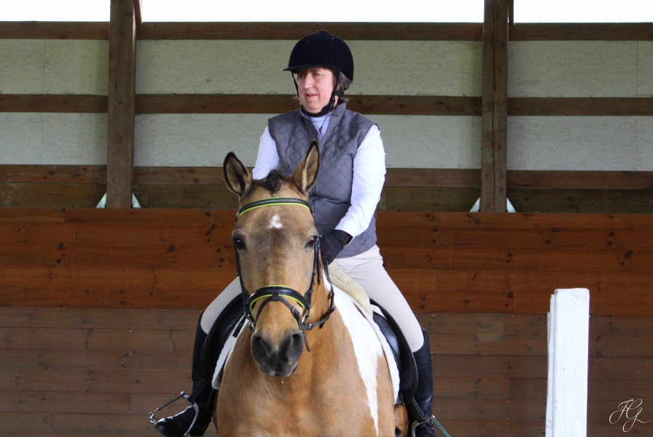
Living Letters Demo
Visually Impaired Rider Video
Rider at Carlisle Academy’s Para-Dressage Symposium, Practicing Use of Callers (Living Letters)

Slide 53
Modifications or Adaptations of
Saddlery: raised pieces on the saddle, special reins, stirrups, hand- hold
Riding attire: riding footwear, no gloves
Other riding equipment: whips, spurs
Postural supports and orthoses: straps to control body parts, prostheses, braces
Note: An aid may be used if it is approved for all Para-Equestrians, or it is indicated on the Athlete Master List/Dispensation Certificate; not all aids listed are required to be used.

Slide 54
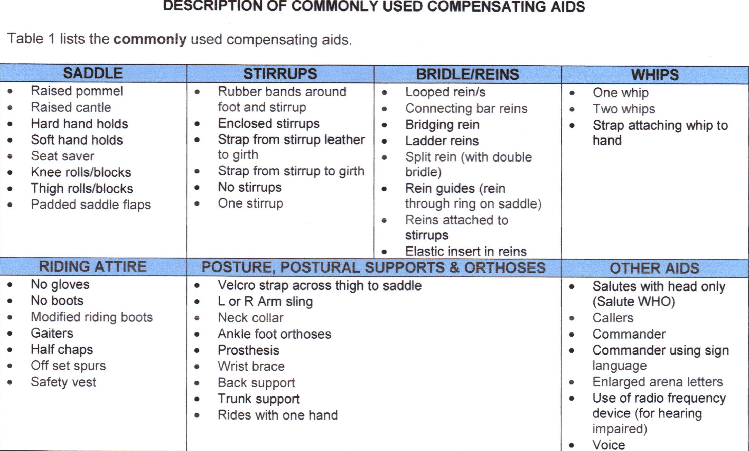
Compensating Aids

Slide 55
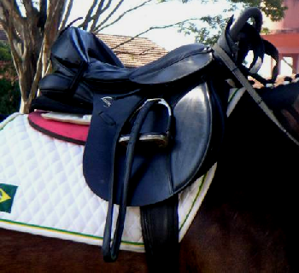
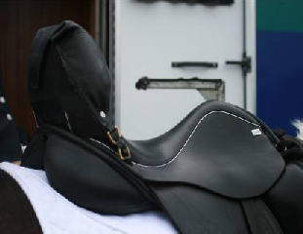
Compensating Aids
INCORRECT - CANTLE TOO HIGH
greater than 12 cm. from seat to
top of cantle
Measurement of the
depth of the saddle
when seat is pressed
down, distance from
seat to top of cantle
or pommel is no
greater than 12 cm.
Adapted saddle with raised cantle and seat saver (also single solid hand hold)

Slide 56
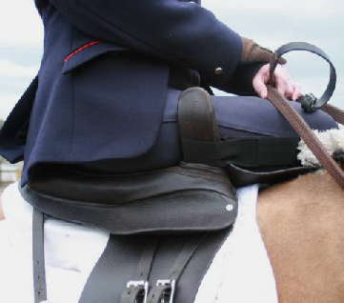
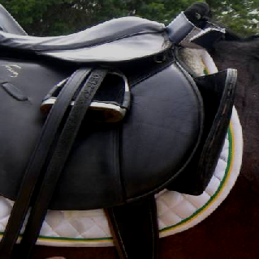
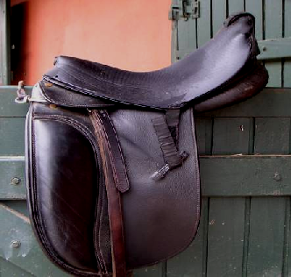
Compensating Aids
A seat saver is a removable attachment to the seat of the saddle for padding to protect the skin of those
competitors with impaired sensation. Seat savers may be made of various materials such as leather, lambs wool or synthetic material.
Adapted saddle with knee guides
Side saddle

Slide 57
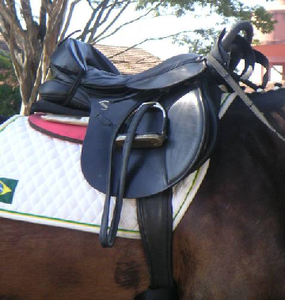
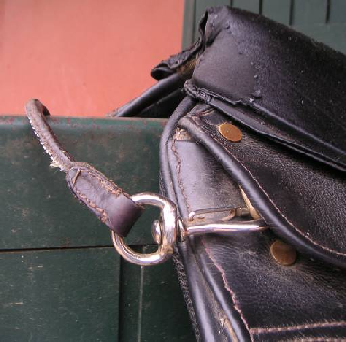
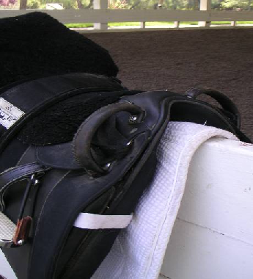
Compensating Aids
Saddle with double hard
hand hold
Saddle with single, hard
hand hold Velcro to assist foot to stirrup Devonshire boot
Saddle with soft hand hold
across the pommel

Slide 58
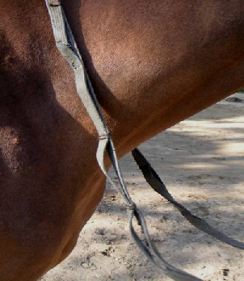
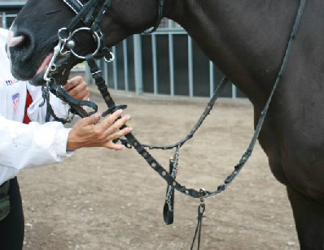
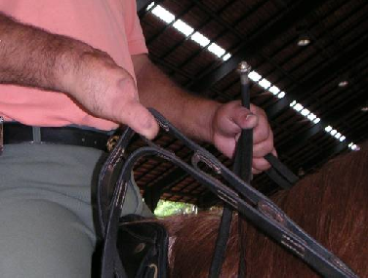
Compensating Aids
EXAMPLES OF LOOPED REINS

Slide 59
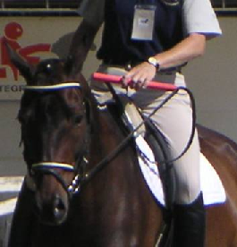
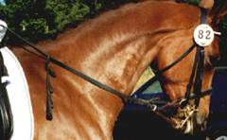
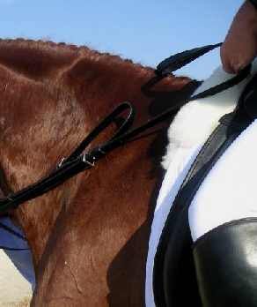
Compensating Aids
LOOPED REIN
Double bridle with split rein and looped rein
Connecting rein bar for one handed riding and rein control

Slide 60
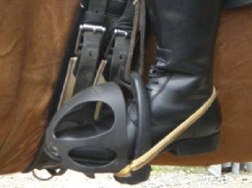
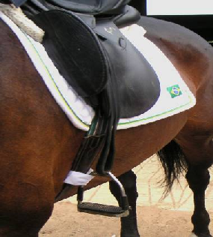
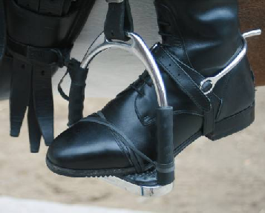
Compensating Aids
Stirrup secured to girth
Rubber band securing the foot to the stirrup
Devonshire boot and foot secured with rubber band around the heel

Slide 61
USEF Dispensation Certificate
A USEF Dispensation Certificate is issued by the USEF for athletes with disabilities in any discipline.
The Certificate indicates the Athlete’s Name/Profile/Grade/Grade Status (if classified), approved compensating aids and expiration date.
It is submitted with the entry for show organizers and officials at recognized shows to indicate allowed compensating aids.
Athletes competing in standard equipment and attire do not need a Dispensation Certificate.
Para-Dressage athletes with dispensation certificates who enter a traditional dressage test (non-para) must include the dispensation certificate with the class entry.
Athletes competing at FEI do not need to submit their USEF Dispensation Certificate, as the aids will be indicated on the FEI Master List.

Slide 62
FEI Standard & Non-Standard Compensating Aids
Standard Aids are approved by the classifier based on the assigned profile/grade and function of the athlete.
Non-Standard Aids must be approved by the FEI Compensating Aids Committee with proof that the aid is safe and humane for the athlete and the horse.
Note: The use of an aid can be revoked by any official if they note that the aid is unsafe or inhumane.

Slide 63
Under Review
The FEI is in the process of reviewing the non-standard aids, with the goal of limiting their use.
It is important for all athletes and coaches to stay apprised of the FEI annual updates.

Slide 64
Helpful Links
Dispensation Certificate
Summary of Standard & Non-Standard Compensating Aids
Application for Dispensation Certificates can be made by contacting USEF Para-Equestrian Director,
Laureen Johnson, lkjohnson@usef.org

Slide 65
Other Show Attire
Protective headgear must be worn by athletes (as well as any other person) at all times while mounted.
Helmets may not be removed for salutes or mounted prize-giving ceremonies.
Athlete with Functional Profile number 36 (Blind) riding in Grade IV no longer are required to wear a blindfold, blacked out glasses or goggles while competing.
An armband in a distinctive color must be worn at all times by Grade IV and V athletes with visual impairment while mounted outside of the competition arena.
Military, police, etc. may wear civil or service dress at all USEF recognized competitions.

Slide 66
Other Tack/Equipment
Athletes must use snaffle or double bridles in all Grades. The minimum diameter of the mouthpiece must be 12 mm for curb bit and 10 mm for bridoon bit (measured adjacent to the rings).
The use of a soft hand-hold (30 cm wide, 10 cm above the top of the pommel) may be attached to the front of the saddle.
Velcro may be used to assist the athlete in the saddle. The total amount of Velcro must not be more than 50 cm2 and must not exceed the dimensions of 3cmx6cm of overlap contact. For safety reasons, it must be fastened in a “V” shape. Velcro or similar material must, in all cases, allow the athlete to fall free of the horse. Will be checked by the Steward.
Ear Hoods: Ear hoods are permitted for all Events. They may provide noise reduction. But ear plugs are not permitted while competing but they are allowed at prize giving ceremony.

Slide 67
Arena and Exercise Areas at Competitions
Arena dimension:
Grades I, II and III - 20X40 meters.
Grades IV and V - 20X60 meters.
Letters placed about 50 cm from the fence and clearly marked. It’s compulsory to place a marker on the fence itself, level with and in addition to the letter concerned. Letters should also be visible by the public.
A part of the fence at A (2m minimum) should be removed and placed back after the rider entered the arena. The arena should be closed during the test.
A practice arena must be available for athletes with visual impairments to train alone (times will be arranged by the Chief Steward).

Slide 68
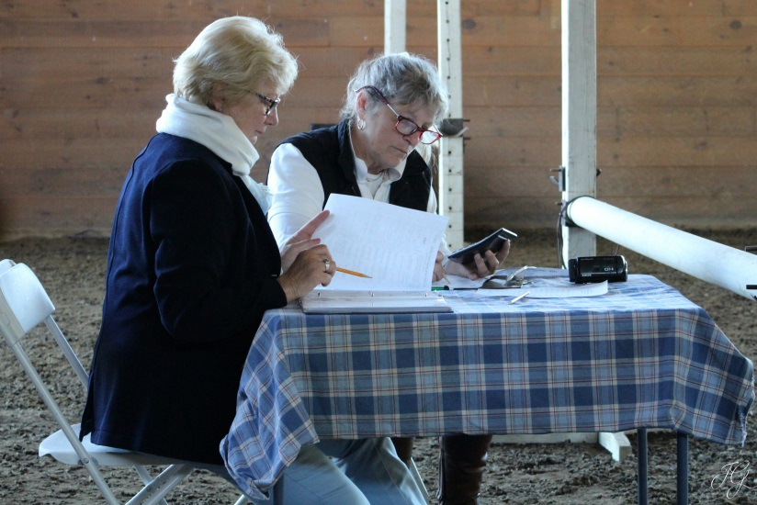
Judge’s Sheets/Scores
A corrected score must be initialled by the judge.
Judges’ scores must be recorded in ink.
Marks of 5 and below will be justified by remarks. The other marks also need comments.
0.5 marks may also be used both for movements and collective marks, at discretion of the judge.
The judge at C must sign the results sheets after the class is finished, before they can be published.
Once the classes have been completed and the rider has received the test, he/she has 30 minutes to review score calculations.

Slide 69
Prize Giving
Participation in the Prize-Giving Ceremony of placed athletes is compulsory. Failure to do so entails losing the placing and prize.
Dress and saddlery have to be the same as in the competition; however, black or white bandages are allowed. Helmets may not be removed at mounted Prize Giving.
It is recommended to do all Prize Giving dismounted.

Slide 70
What are the Judge’s Looking for in Each Movement?
FEI Guidelines for the “Marking of Fundamental Mistakes in Para‐Equestrian Dressage Movements”

Slide 71
Judges and Trainers will follow the Training Scale as in Able-Bodied Dressage

Slide 72
Collective marks in all Grades
Paces: Freedom and Regularity
Activity: Desire to move forward, elasticity of the steps, suppleness of the back and engagement of the hindquarters
Submission: Attention and confidence, harmony, lightness and ease of movements, straightness, acceptance of the bridle and lightness of the forehand.
Equestrian feel and skill of the athlete in terms of accuracy

Slide 73
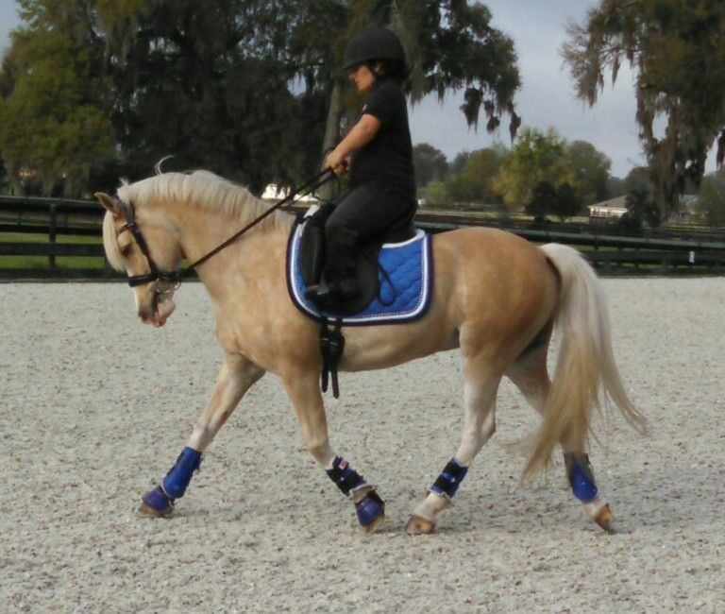
Judges will Never Judge the Position of the Rider
The judges will look only for the performance of the horse in the test. Even if the aid is given in a slightly unusual way, the quality achieved is the most important consideration.

Slide 74
Requirements in Grade I
Walk Rhythm: Regularity of a Clear 4-beat rhythm.
Suppleness: Elasticity/ Freedom and Lack of Tension.
Natural Balance with an uphill tendency.
Consistent and active tempo, hind legs correctly engaged.
On the bit with a soft and (as steady as possible) contact (never behind the bit or on the forehand).
Stretch on the longer rein: 4-beat rhythm with clear difference in the frame and clear overtracking.
3 equal loops 5m either side of center line
There must be harmony/understanding between athlete and horse.

Slide 75
Requirements in Grade II
Walk rhythm: Same requirements as in Grade I.
Trot Rhythm: Clear 2-beat rhythm with a clear moment of suspension.
Leg yield at walk (no turn on haunches)
Suppleness throughout the body swinging back and elastic steps with clear energy.
A consistent contact (if possible) with the horse in self carriage.
Some lengthening strides: Bigger steps with more over tracking and smooth transitions.
Transitions between paces should be in balance, fluid and on the bit.
Harmony between athlete and horse is very important.

Slide 76
Requirements in Grade III
Clear Walk and Trot Rhythm in all movements (see Training Scale)
Circles of 8 or 10 meters
Serpentines with 3 and 4 loops at trot, with transitions to medium walk across center line.
Transitions have to be prompt, fluid and in balance.
Half turn on haunches
Leg yield at trot
Rein back: 2-4 steps: The judge will look for the balance in the halt, (and all 3 transitions), diagonal steps in rein back, willingness, steadiness, uphill tendency, and contact.
Higher marks for the clear quality walk between the turns.

Slide 77
Requirements in Grade IV
Walk, Trot and Canter Tests.
Regularity with a three–beat rhythm and a clear moment of suspension.
Balance and uphill tendency, well engaged hind legs and carrying weight in haunches.
Collected trot, collected canter, medium walk
Medium canter on 20m circle, collected canter on a 10m loop, collected trot on a 5m loop.

Slide 78
Requirements in Grade V
Walk, Trot and Canter Tests
Elastic and steady contact with the poll as the highest point. The movement must be collected, balanced and fluid.
Lateral Work in Trot and Canter: the pace should remain free with steady impulsion, cadenced and balanced.
Collection in All Gaits: development of the carrying power of the hindquarters and balance. More engagement, activity and flexion of the hind leg joints. Forehand lighter and more mobile. Light and soft contact.
Simple Change of Lead: quality of canter, quality of the transitions, quality of the walk (3-5 steps clearly defined steps), straight and relaxed.
Shoulder in on center line, walk half pirouette on a diagonal at X
Rein back to trot on center line at end.

Slide 79
Requirements in the Freestyle
Each Grade has its own Freestyle Tests, with different size of arenas and time allowed.
The requirements can be found on each of the test sheets.
The sheets are divided into Technical Movements
There are artistic Marks with coefficient : Rhythm, Suppleness and Energy; Harmony between Rider and Horse; Choreography, Use of Arena, Inventiveness ; Musical Interpretation
The allowed movements and forbidden movements have to be followed very carefully. Some permitted movements can be shown but they are different in each grade.
0 points for compulsory movements not shown.

Slide 80
Freestyle Tests
Freestyle tests will be timed from the move off after the first halt to the final salute.
The halts must be shown on the center line facing the judge at C.
The music must cease at the final salute.
In case of a competitors music failing during the test and where there is no back up system, the rider should leave the arena after consulting with the judge at C. The C judge may allow the rider enter again during a scheduled break. Marks given up to the interruption the freestyle will remain unchanged.

Slide 81
In All Grades
No free walk anymore but stretching on a longer rein (I, II, III) and extended walk (IV, V).
Movement -STRETCH ON A LONGER REIN - not on a LONG rein.
Considering that the athletes have different impairments and that giving the reins will be influenced by them, this was one reason why the Free Walk was taken out where the contact should be given up completely.
Secondly, it’s indicated in the directives that the maintenance of rhythm, and activity, as well as the relaxation and the stretching forward downward are the most important aspects of this movement. A positive effect of the relaxation and the stretching is a lengthening of the frame and the steps, but we would never ask for and judge an overtrack like for an Extended walk. We want to check whether the horse is really through the back and accepts and follows the bit. For the transition, the gradually fluent and smooth giving and the non-resistant taking of the reins should be judged.

Slide 82
Other USEF Para-Dressage Video Clips
US Equestrian’s Official Para-Dressage Video
Video of U.S. Para-Dressage National Championships Tryon 2017

Slide 83
What defines a Para-Equestrian High Performance Athlete?
Trains 5-6x a week (has back up horse).
Competes and excels consistently at national and international shows (High 60’s & 70s).
Crosstrains to be at his/her best.
Prepares mentally, physically, and nutritionally.
Is involved in his/her community and local dressage clubs, and in promoting and building the sport.
Is determined, dedicated, driven, disciplined, and diplomatic.
Analyzes performance, sets targets, and reviews progress
Defines success as winning on the world stage, not winning in the U.S. or at Selection Trials.

Slide 84
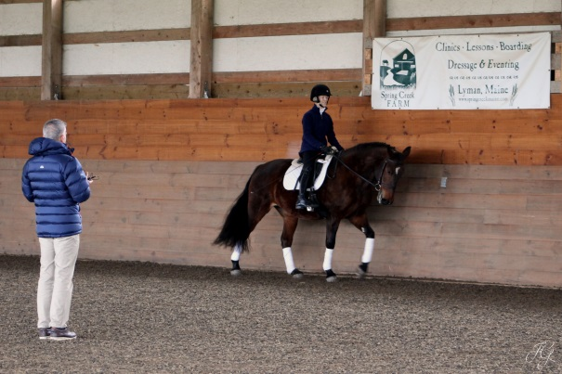
How Can Coaches Support Athletes Along the Competition Pathway?
Create an optimal talent environment
Develop winning habits and nurture athlete development
Engender characteristic of resiliency, self-belief, professional attitude, team player, leadership
Set clear standards and expectations, accountability
Stay adaptive, open, and creative
Be willing to think outside the “proverbial box”
Continue with own coach development and continuing education with USEF Para-Dressage Coach Development Program .
Be collaborative in learning from other coaches with unique para-dressage experience.

Slide 85
Develop a Competition Team
Athletes/Coaches need to design traveling support structure of groom, horse owner, caregivers to go to competitions. (Imperative for Grades I, II, and III but highly recommended for all grades)
Coaches need to know athlete’s show routine and protect mental preparation time/space, and help conserve athlete’s physical energy
Find support individuals who will help spread the word, build PR, website, newsletter, articles, fundraisers.

Slide 86
Develop a Plan & Budget
Assist athlete in developing a 4-8 year plan, with an annual budget geared toward overall goal.
Include everything that it will take: Securing a Horse, Training, Lessons, Farrier, Vet, Clinics, Shows & Competitions, PR, Website, Fundraising, Sponsors, Equipment & Tack.
Shows/Competitions: Entry/stabling fees, transport fees, travel, hotel, groom, trainer, assistant, braider, security, offsite stabling before and/or after the show
Include membership fees: USPEA, USEF, USDF, FEI, local dressage clubs.

Slide 87
Resources & Links
Federation Equestrian International
www.fei.org
International Governing Body. Oversight for International Competition, Including International Level Rules and Classification
United States Equestrian Federation
www.usef.org
National Governing Body, Oversight for National Competition, Including National Level Rules and Classification
United States Para-Equestrian Association
www.uspea.org
Official Para-Dressage Affiliate to USEF, Oversight for Grassroots Education & Talent Development

Slide 88
These presentations are part of a library of Para-Equestrian educational courses which include:
Introduction to Para-Equestrian Dressage
Introduction to Para-Equestrian Driving
Understanding Para-Equestrian Classification

Slide 89
Attributions:
Course material was produced and narrated by Sarah Armentrout
Head of School, Carlisle Academy, October 2017
-----------------
with contributions from
Will Connell, USEF Sport Director
Michel Assouline, USEF Para-Dressage Coach Development Director
Laureen Johnson, USEF Para-Equestrian Discipline Director
Hope Hand, USPEA President
J.H. Gerritsen, 5* FEI Paralympic Dressage Judge
Joann Benjamin PT, HPCS, FEI Classifier
Tina Wentz, PT, FEI Classifier
Kerri Sowers, PT, DPT, NCS, FEI Classifier
© 2017 Copyright owned by United States Equestrian Federation
Duplication or disbursement of this material is by permission only.

