Slide 1
Understanding
Classification for
Para-Equestrian Sports
For Coaches & Athletes

Slide 2
Development of this course is made possible by
Funding provided through the Department of Veterans Affairs Adaptive Sports Grant to Carlisle Academy Integrative Equine Therapy & Sports in partnership with the United States Equestrian Federation and the Professional Association of Therapeutic Horsemanship, International.
Disclaimer: This program is funded in part by a grant from the United States Department of Veterans Affairs. The opinions, findings, and conclusions stated herein are those of the author and do not necessarily reflect those of the United States Department of Veterans Affairs.

Slide 3
Disclaimer
The information in this presentation may not perfectly reflect the most updated USEF/FEI Para-Equestrian rules.
It is the responsibility of the athlete to check the USEF/FEI Para-Equestrian Rules updated annually.

Slide 4
Course Objectives
To develop a foundational understanding of National and International competition in Para-Equestrian Sports, specifically Para-Dressage & Para-Driving.
To raise awareness among riding schools, therapeutic riding centers, veteran service organizations and adaptive sport clubs about these exciting Paralympic and International equestrian sports as a competitive pursuit beyond equine-assisted therapy or recreation.
Connect emerging coaches and athletes to the USEF/USPEA International Para-Equestrian Dressage Centers of Excellence which provide training clinics, educational symposia, and access to international para-dressage coaching experts.
Encourage para-eligible veterans to participate in the Department of Veterans Affairs’ Veteran Assistance Program for Paralympic Athletes with trained, knowledgeable coaching support.

Slide 5
Presenter Kerri Sowers PT, DPT, PhD(c) Kerri Sowers is an Assistant Professor of Health Science at Stockton University in Galloway, New Jersey. She is a Fédération Equestre Internationale Level 2 Classifier for Para-equestrian sport, a United States Equestrian Federation National Classifier, and serves on the United States Equestrian Federation Adaptive Sports Committee. In addition to her experience as a classifier, Kerri is an accomplished dressage rider, who has competed successfully through the FEI levels.

Slide 6
What is Classification?
“Grouping athletes into sport classes according to how much of their impairment affects fundamental activities in each specific sport of discipline.”
(IPC, 2015)

Slide 7
Brief History of Classification
Began in the 1950s, shortly after Dr. Guttman founded para sports.
Started as an impairment-based system
Separate sport classes for different medical diagnoses.
1980s: classification transitioned to a functional-based system.
Currently…
Focus is on evidence-based classification

Slide 8
PE Classification
Physical Impairment
Physio
Doctor
Accredited to classify
Vision Impairment
Ophthalmologist or optician who is an accredited vision classifier
Intellectual Impairment
Not eligible without a classifiable physical or visual impairment

Slide 9
National vs. International

Slide 10
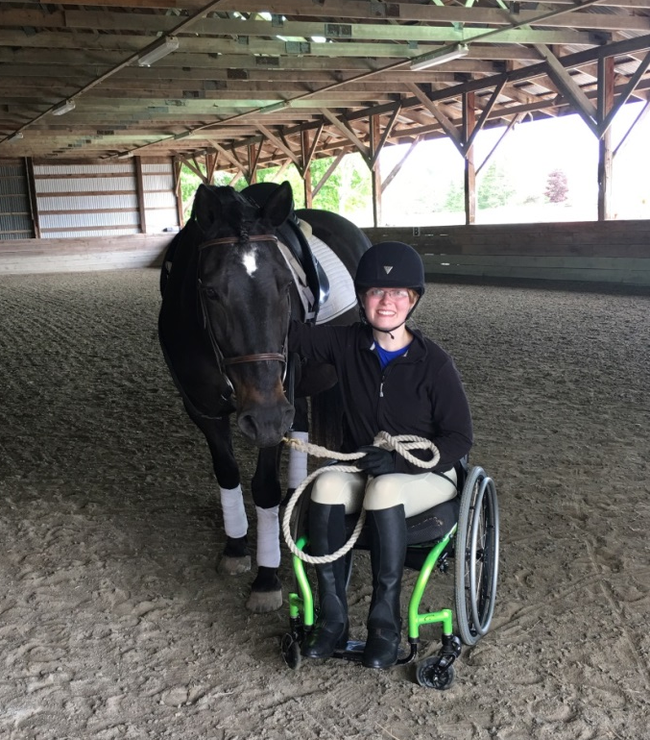
Permitted Impairments
Impaired muscle power (strength)
Impaired passive range of movement
Loss of limb or limb deficiency
Leg-length difference
Short stature
Hypertonia
Ataxia
Athetosis
Visual impairment
Intellectual impairment**
**Not included in PE sport, unless combined with physical or visual impairment

Slide 11
Minimal Impairment Criteria
There must be more than 15% loss of function in an area.
Each impairment must be able to be measured objectively.

Slide 12
The Classification Process
Determine Eligibility to be Classified
Apply to the National Federation
Permanent, measurable movement or vision impairment verified by medical documentation
Determine eligibility for competition
Athlete meets Minimal Impairment Criteria
Allocate Profile and Grade
Designate Grade Status
N, R, C

Slide 13
Classification Procedure
Athlete Interview
Select Assessment Scale(s)
Assess Athlete
Select Functional Profile and Grade
Observe on and off the horse
Confirm the competition grade

Slide 14
Classification Assessment
Application
Consent for classification
Certificate of Medical diagnosis – verification of diagnosis by a doctor
May require additional medical reports (MRI, EMG, Radiographs)
Athlete interview
Medical history, current impairments, medications, compensating aids
Selection of measurement tools by Classifier
Power/strength, range of motion, and/or coordination

Slide 15
Classification Assessment
Determination of a Profile and Grade (Sport Class)
Determination of Status
New, Review, Confirmed
Compensating Aids
Based on profile
Non-standard aids require further approval

Slide 16
Classification Assessment
Power/Strength
Range of Motion
Coordination
Vision
*AS RELATED to the SPORT*
*What is NOT considered: endurance/fatigue, pain, hypersensitivity, hyperflexibility, hypotonia

Slide 17
Classification Profiles
37 eligible Profiles for PE sport
Additional Profiles for non-eligible condition
Profiles with similar functional impairments or activity limitations are grouped together into the same Grade/Sport Class

Slide 18
Dressage Classification Grades
Grade I: Severe impairments affecting all 4 limbs and trunk. Athlete typically requires use of a wheelchair. May be able to walk with an unsteady gait. Trunk and balance are severely impaired.
Grade II: Severe impairment of the trunk and minimal impairment of the upper limbs, or moderate impairment of the trunk, upper, and lower limbs. Most use a wheelchair.
Grade III: Severe impairments in both lower limbs with minimal or no impairment of the trunk or moderate impairment of the upper and lower limbs, and trunk. Some may use a wheelchair.

Slide 19
Dressage Classification Grades
Grade IV: Severe impairment or deficiency of both upper limbs or a moderate impairment of all 4 limbs or short stature. Able to walk, typically do not use a wheelchair. Includes B1 visual impairment.
Grade V: Mild impairment of movement or muscle strength or deficiency of one limb or mild deficiency of 2 limbs. Includes B2 visual impairment.
Grade NE: Athletes who do not meet the minimal eligibility criteria, do not have a qualifying medical diagnosis, or are not able to complete the classification testing due to pain.

Slide 20
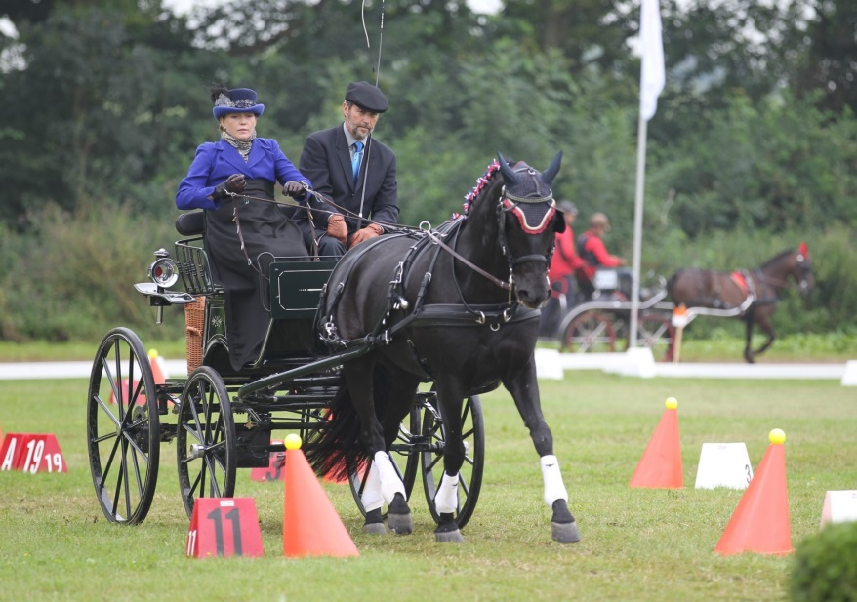
Para-Driving Classification
Uses the same Profiles as PE Dressage
Not all profiles are eligible for para-driving
Only 2 Grades are available
Classification procedure is the same, but takes into account different physical requirements of driving

Slide 21
Driving Classification Grades
Grade I: Moderate to severe impairment in all 4 limbs and trunk who may not be able to walk; moderate to severe impairment in 3 limbs and trunk; severe impairment in two unilateral limbs and trunk; severe impairment in upper limbs and trunk; severe impairment in upper limbs with mild impairment in lower limbs; severe impairment in upper limbs. Most athlete will use a wheelchair in daily life for some or all mobility.
Grade II: Includes a range of impairments, such as: mild impairment of all 4 limbs and trunk; severe to moderate impairment in 1 or 2 lower limbs; 2 limbs on the same side; moderate to mild impairment of 1 or 2 upper limbs. Less impairment compared to Grade I.
Not Eligible: Profiles 20, 23, 29, 30, 36, 37a, 37b, 38, 39, 41, 48

Slide 22
PE Classification Status
NEW: athletes in the process of completing classification; have completed the bench testing, but not the riding observation.
REVIEW: athletes who have been assigned a Profile/Grade but may have recent impairments or are subject to change (for example: multiple sclerosis); will be given a review date.
CONFIRMED: athletes who have been assigned a Profile/Grade and do not require further evaluation; impairments that are stable, with no expectation of change.

Slide 23
Re-classification
There are protest or appeal procedures available to the athlete at a FEI competition (see FEI Classification Manual).
USEF follows FEI rules and Classification Manual regarding classification and reclassification.
Re-classification will be considered only for athletes who are designated Review, or with the submission of evidence of a change in medical status or the onset of a new medical condition.

Slide 24
Classification Issues
Misrepresentation
Intentional cheating
Pain
Proof of misrepresentation
Medications
Fatigue or fluctuating conditions
New injuries
Legal concerns
Lawsuits
“Permission” to compete
Classifier experience

Slide 25
Future of Classification
IPC movement towards evidence-based, sport-specific classification process.
FEI is beginning significant research projects relating to the classification system.
What is actually needed for PE sport (dressage is being researched first).
How will the sport requirements impact the current system?
Reassessment of the minimal impairment criteria.
Assessment of the impact of visual or intellectual impairments.
Overall goal of keeping PE sport in the Paralympic Games.
Sport must be easy to understand by spectators.

Slide 26
How to find a Classifier in your Area?
For a U.S. (National) or FEI (International) Classification, please contact:
LAUREEN K. JOHNSON, USEF Director Para-Equestrian & Vaulting; lkjohnson@usef.org

Slide 27
Resources
Federation Equestrian International
www.fei.org
International Governing Body. Oversight for International Competition, Including International Level Rules and Classification
United States Equestrian Federation
www.usef.org
National Governing Body, Oversight for National Competition, Including National Level Rules and Classification
United States Para-Equestrian Association
www.uspea.org
Official Para-Dressage Affiliate to USEF, Oversight for Grassroots Education & Talent Development

Slide 28
Links
FEI Classification Manual COPY

Slide 29
These presentations are part of a library of Para-Equestrian educational courses which include:
Introduction to Para-Equestrian Dressage
Introduction to Para-Equestrian Driving
Understanding Para-Equestrian Classification

Slide 30
Attributions
Course material was produced and narrated by Sarah Armentrout
Head of School, Carlisle Academy, October 2017
-----------------
with contributions from
Joann Benjamin PT, HPCS, FEI Classifier
Tina Wentz, PT, FEI Classifier
Kerri Sowers, PT, DPT, NCS, FEI Classifier
© 2017 Copyright owned by United States Equestrian Federation.
Duplication or disbursement of this material is by permission only.

